Slide 1

2023 Competitions Statistics
A Study for the EJU Coach Commission

Slide 2
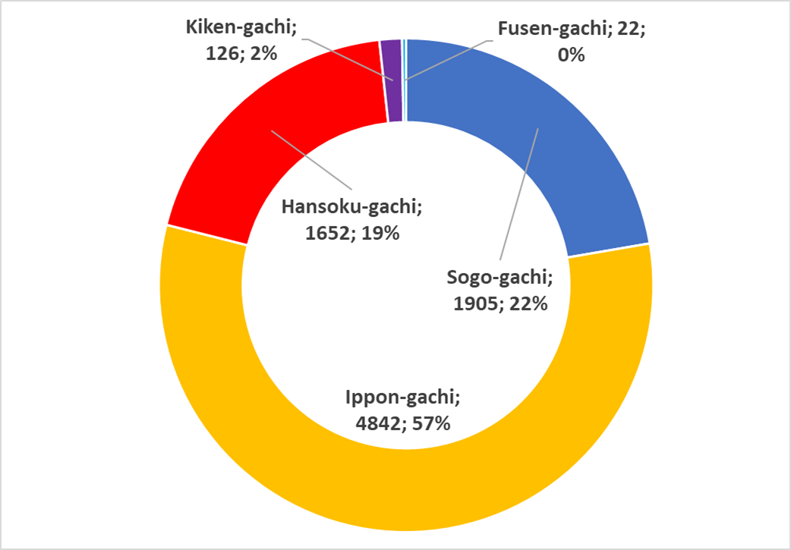
General References to the 2023 Data
17 Analysed Competitions;
  World Championships Senior individual (1)
  Masters (1)
  Grand Slam (10)
  Grand Prix (4)
  World Championships Junior (1)
  Total of analysed fights – 8547
Legend
Ippon-gachi = Victory by Ippon or Waza Ari Awasete Ippon;
Sogno-gachi = Victory by Waza Ari vs No Score;
Hansoku-gachi = Victory by Sum of Penalties or Direct Hansokumake;
Kiken-gachi = Victory by No Show (No Contest);
Fusen-gachi = Victory by Withdrawal due to injury
Note.
79% of fights have an outcome that derives from the Technical Factor (judo technique)

Slide 3
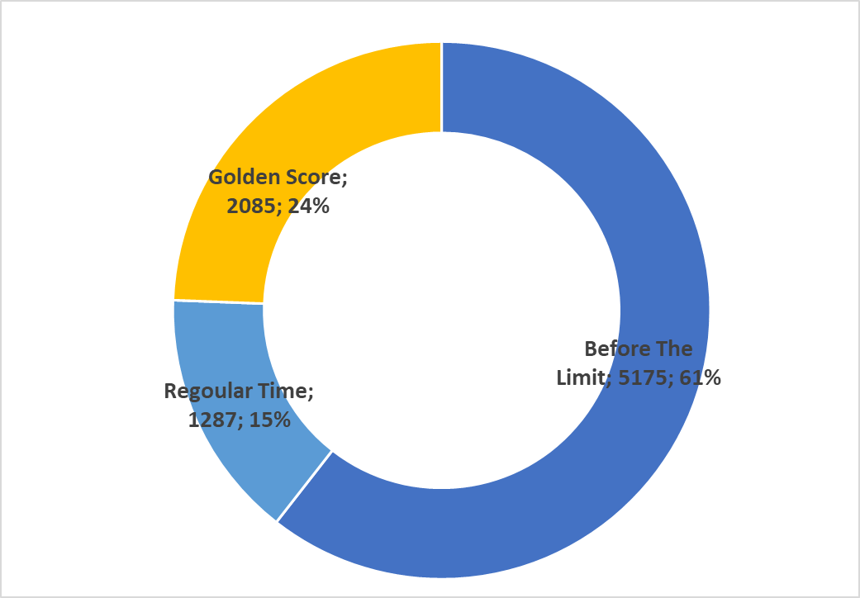
Stats : average of the contests:
Average Contest Duration: 3’35”
Average Golden Score Contest Duration: 6’8”
Average Duration of Contest ended Before the Limit: 2’17”
 | Duration | Competition | Weight Category | Round | White Athlete | Blue Athlete | Referee | Outcome
Shortest Contest | 6’’ | Grand Slam Baku | 70 Kg | Final Repechage | YEATS-BROWN Katie-Jemima GBR | GAHIE Marie Eve FRA | TOTH Brian USA | Ippon-gachi
Longest Contest | 17’34’’ | Grand Slam Baku | 70 Kg | Semi Final | MATIC Barbara CRO | TSUNODA ROUSTANT Ai ESP | GARGOURI Mohamed Ismail TUN | Hansoku-gachi

Slide 4
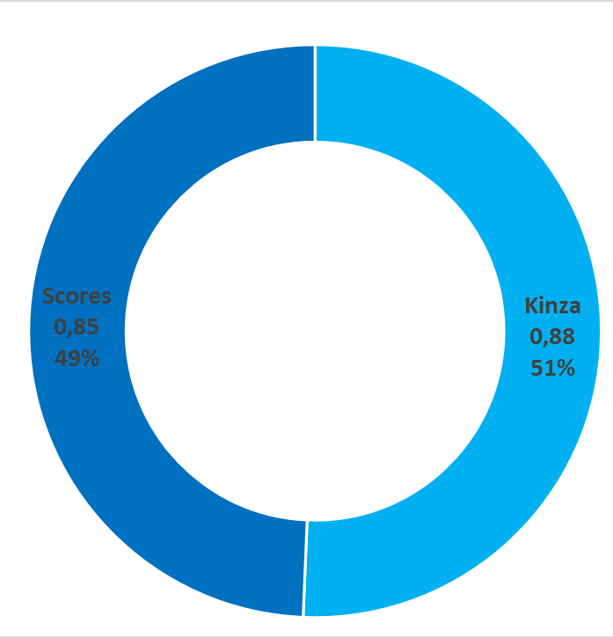
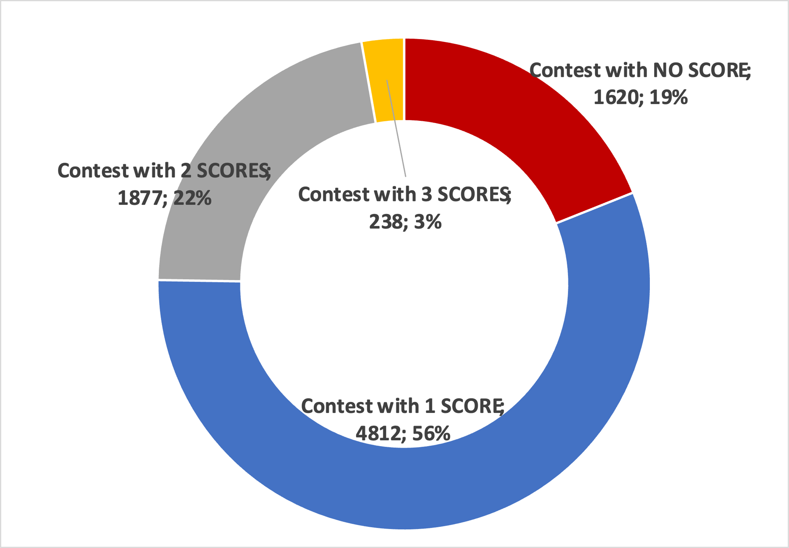
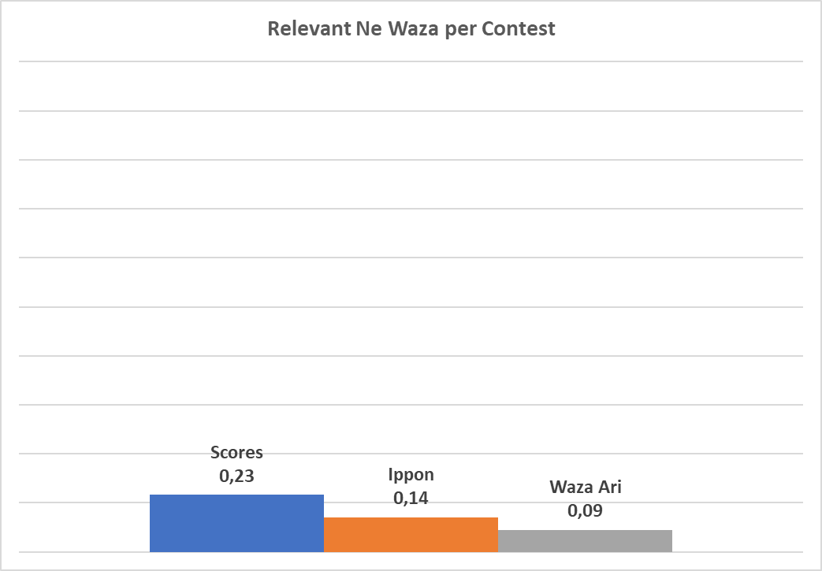
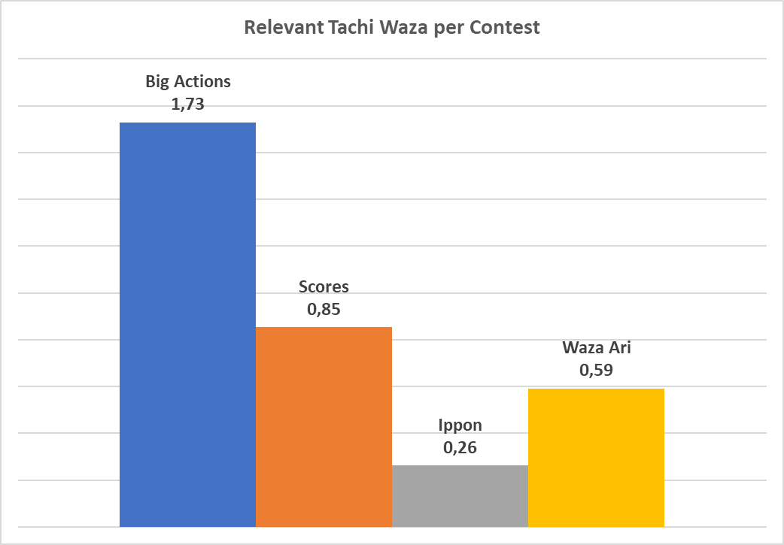
Positive actions per contest
8547 analyzed contests;
7294 scores in tachi waza;
7491 kinza in tachi waza;
1985 scores in ne waza;
Average score per contest: 1,09

Slide 5
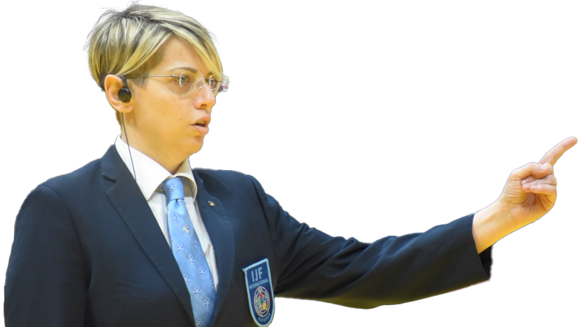
2023 Competitions Statistics – penalties analisis

Slide 6
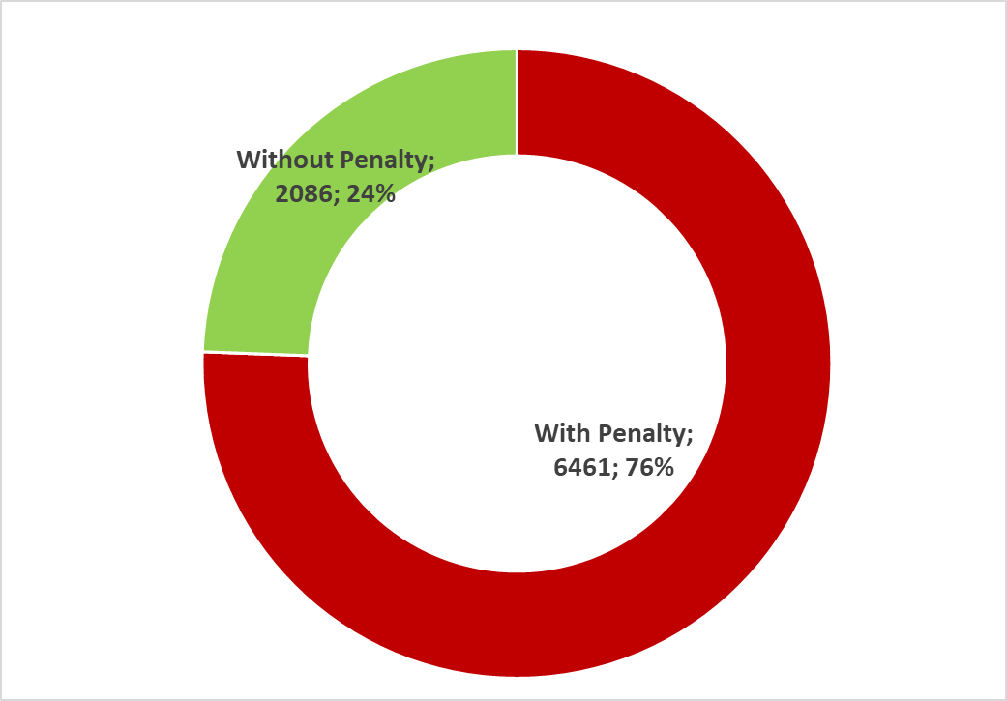
General references to the 2023 penalties data
Contest With: | Number
0 Penalties | 2086
1 Penalties | 1641
2 Penalties | 1634
3 Penalties | 1519
4 Penalties | 1178
5 Penalties | 488
6 Penalties | 1
17 Analyzed competitions;
8547 analyzed contests;
16882 awarded penalties;
  258 cancelled penalties
Average penalties per contest: 1,95
Note:
16624 penalties on the scoreboard

Slide 7
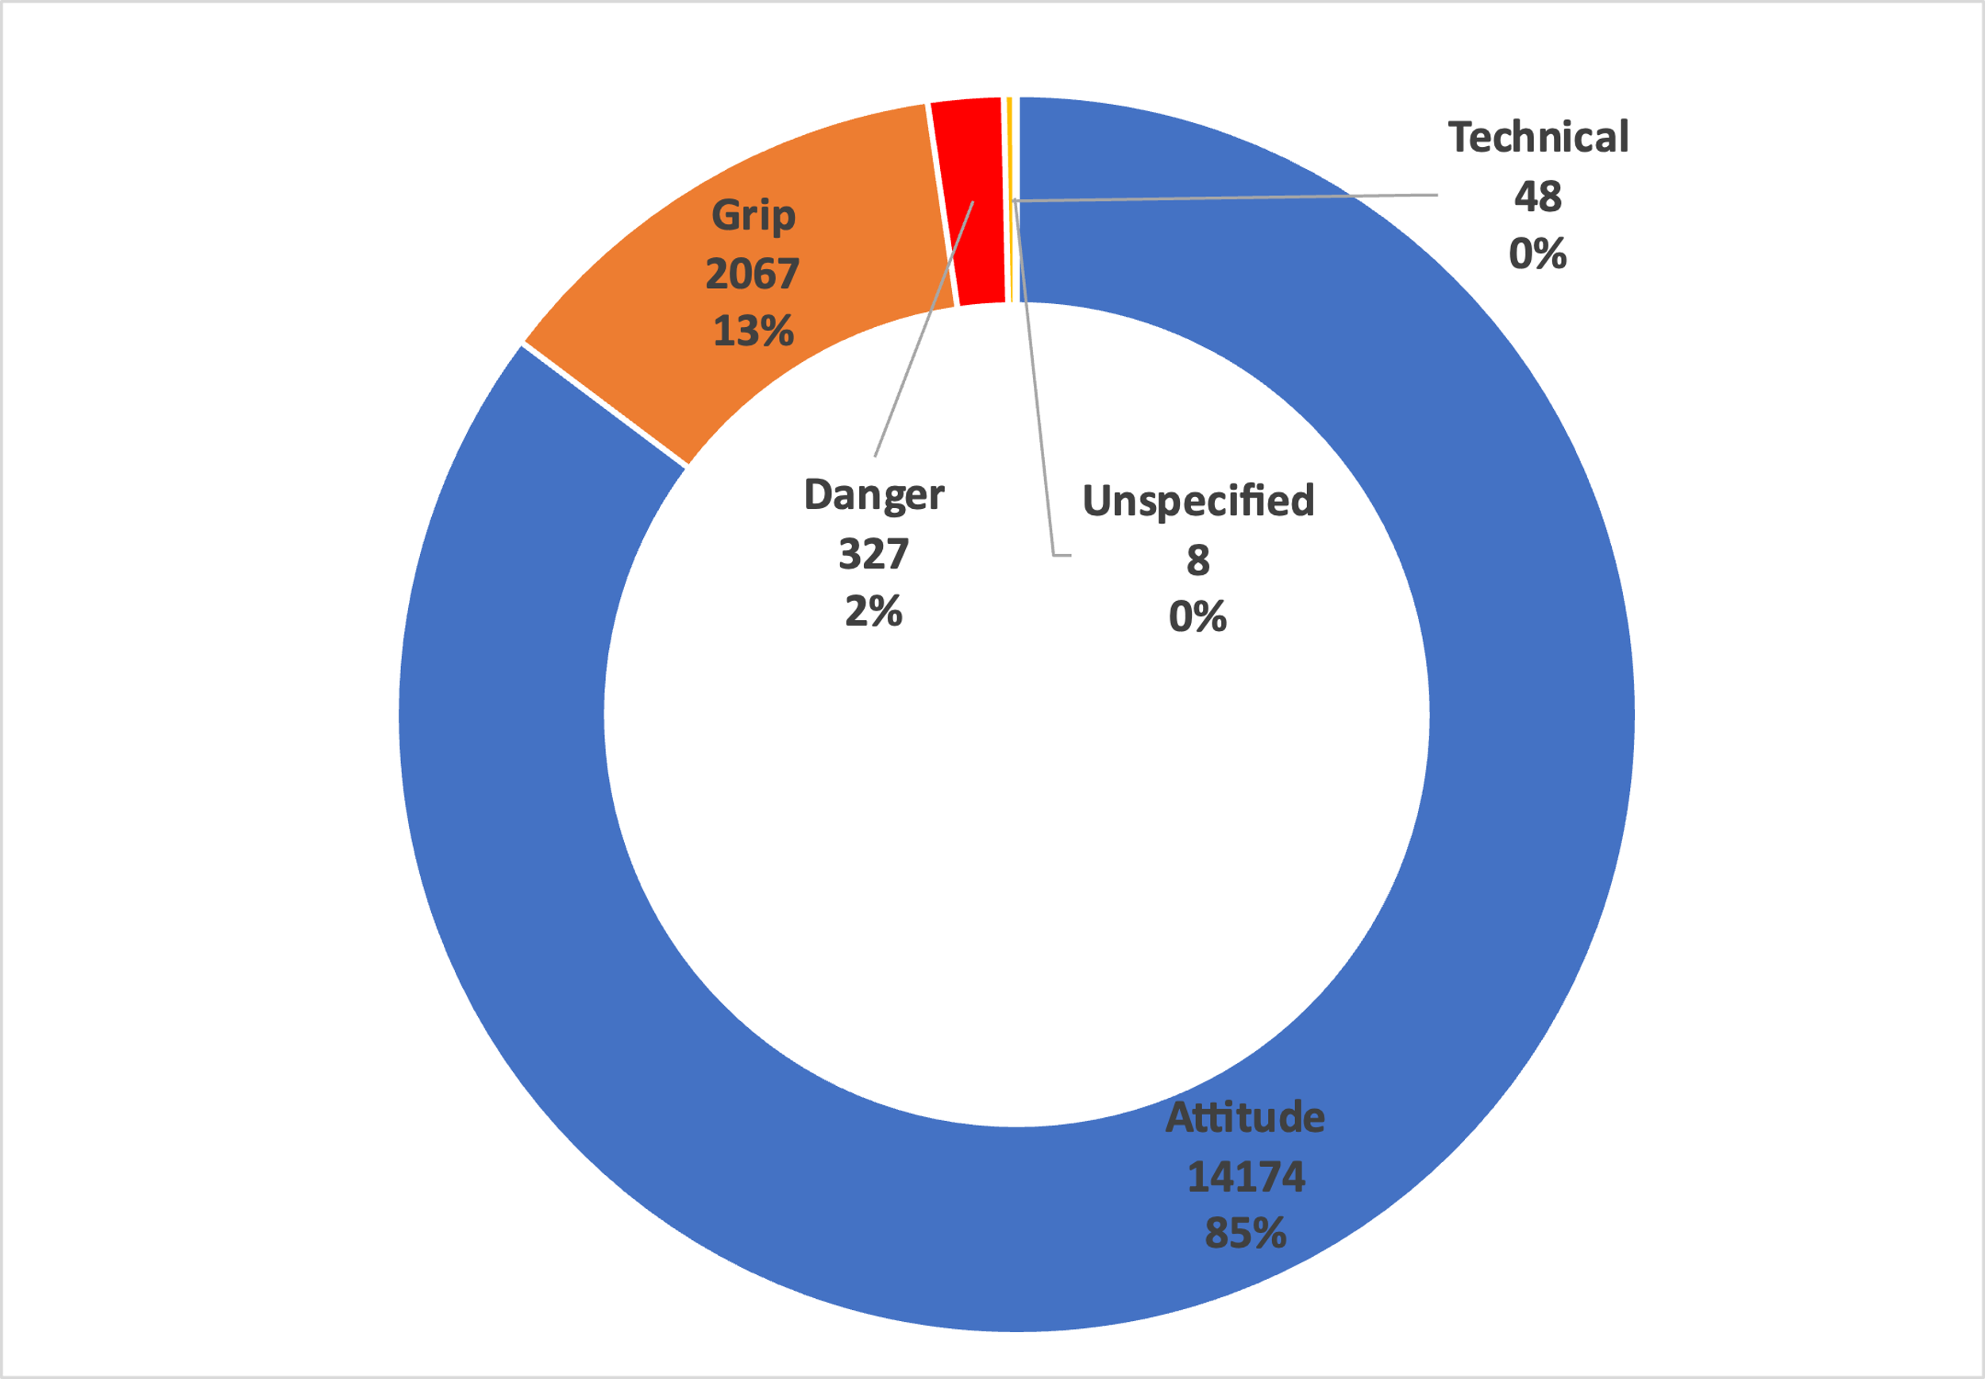
2023 penalties
16624 penalties
46 different types of penalties
Note:
8 times out of 16624 it was not possible to identify the reason for the awarded penalty

Slide 8
Attitude |  | Grip |  | Danger |  | Technical
No combat | 6536 | Single grip | 553 | Diving | 103 | Standing kansetsu waza | 37
Refuse grip | 3779 | Leg grip | 526 | Two hands defence | 92 | Gyaku seoi otoshi | 8
False attack | 1940 | Pistol grip | 226 | Dangerous action | 32 | Standing shime waza | 3
Exit | 823 | One side grip | 203 | Waki gatame | 22
Defensive posture | 817 | Inside grip | 119 | Head defence | 20
Escaping head | 177 | Invalid brek grip | 105 | Setching leg | 17
Leg entaglement | 27 | Two sleeves grip | 97 | Hand on face | 15
Pushing down | 27 | Finger grip | 51 | Back sweep | 9
Judogi out | 18 | Cross grip | 42 | Kawazu gake | 7
Kick | 10 | Bear grip | 42 | Tawara gaeshi | 3
Hair fixing | 6 | Belt grip | 32 | Bridge | 3
Pushing out | 6 | Cover collar | 29 | Head lock | 2
Time waste | 6 | Wrist grip | 21 | Wear dangerous device | 1
Bended position | 1 | Poket grip | 21 | Kani basami | 1
No fair-play | 1

Slide 9
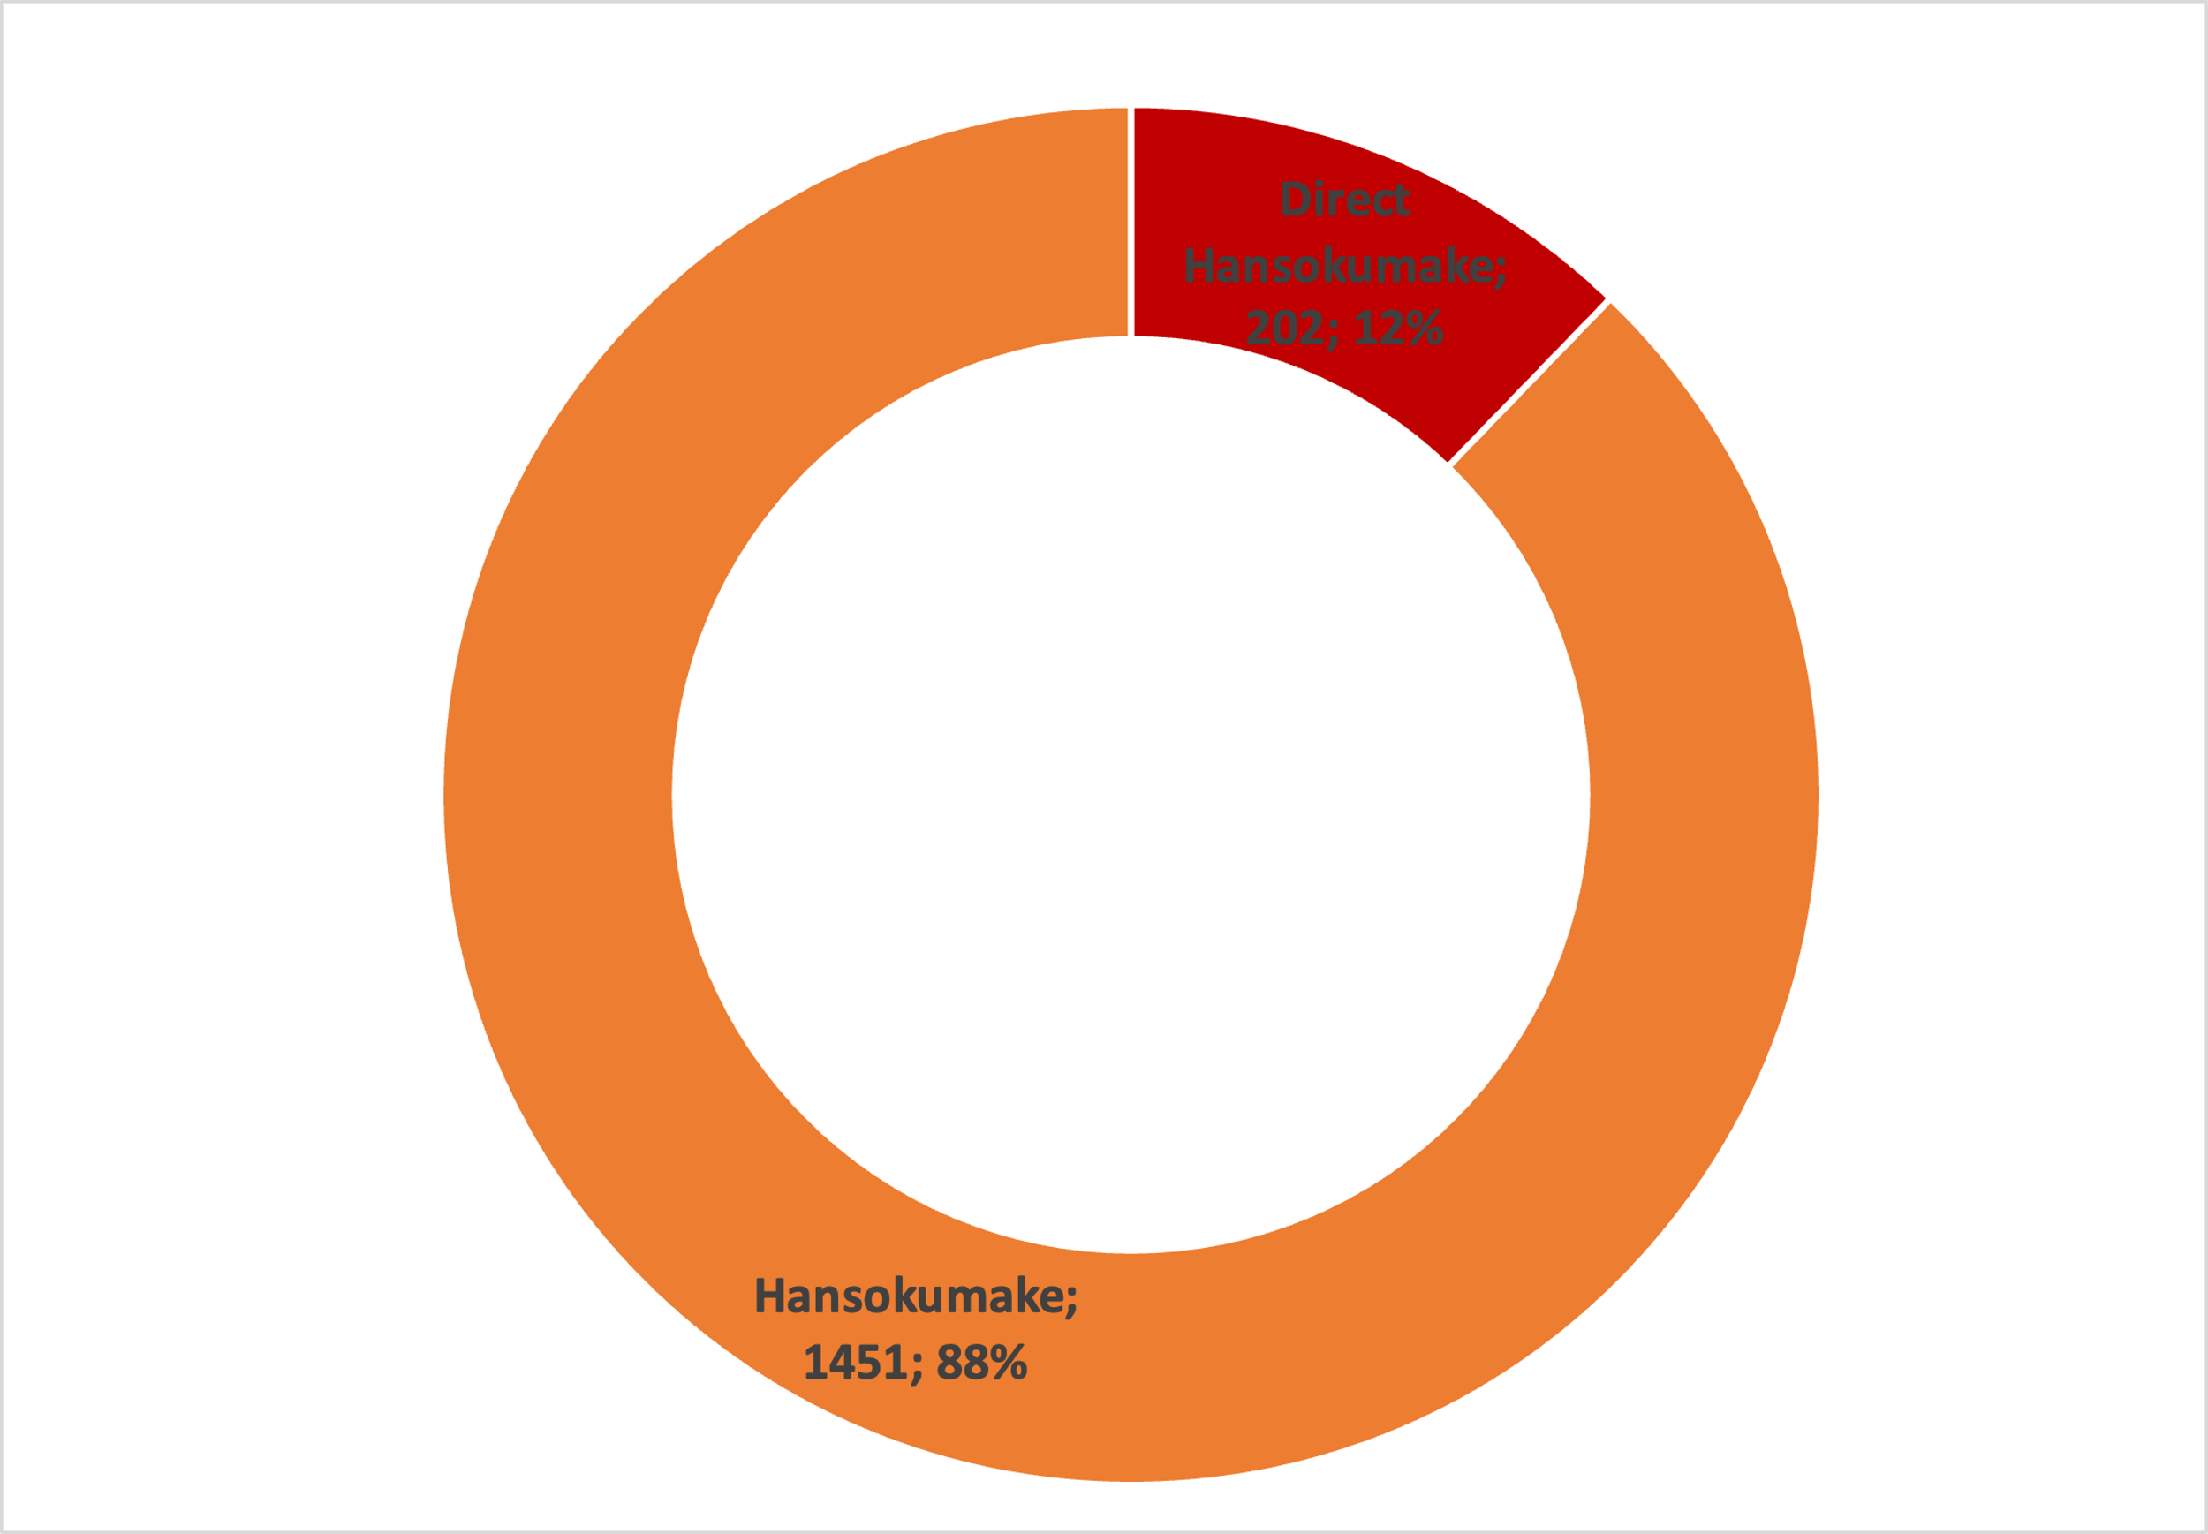
2023 Hansokumake analisis
1652 Hansoku-gachi contest outcome

Slide 10
Hansokumake (sum of warnings) |  | direct hansokumake
No combat | 779 | Diving | 103
False attack | 228 | Dangerous action | 32
Refuse grip | 113 | Waki gatame | 22
Exit | 90 | Head defence | 20
Leg grip | 79 | Back sweep | 9
Defensive posture | 39 | Kawazu gake | 7
Escaping head | 26 | Tawara gaeshi | 3
Bear grip | 15 | Bridge | 3
One side grip | 14 | Kani basami | 1
Two hands defence | 13 | No fair-play | 1
Single grip | 11 | Wear dangerous device | 1
Invalid brek grip | 10
Two sleeves grip | 4
Hair fixing | 3
Inside grip | 3
Pistol grip | 3
Judogi out | 3
Leg entaglement | 3
Gyaku seoi otoshi | 2
Finger grip | 2
Cross grip | 2
Unspecified | 2
Setching leg | 1
Poket grip | 1
Pushing down | 1
Wrist grip | 1
Cover collar | 1
Belt grip | 1
Kick | 1

Slide 11
Penalties per competition
Contests Number | 586 | 562 | 440 | 405 | 461 | 640 | 699 | 496 | 357 | 376 | 386 | 461 | 570 | 488 | 582 | 490 | 548
 | Grand Prix Almada | Grand Slam Paris | Grand Slam Tel Aviv | Grand Slam Tashkent | Grand Slam Tbilisi | Grand Slam Antalya | WCS Doha | Grand Prix Upper | Grand Prix Dushanbe | Grand Slam Astana | Grand Slam Ulaanbaatar | Masters Budapest | Grand Prix Zagreb | Grand Slam Baku | WCJ Odivelas | Grand Slam Abu Dhabi | Grand Slam Tokyo
No Combat | 451 | 468 | 362 | 344 | 345 | 465 | 549 | 359 | 277 | 349 | 295 | 353 | 416 | 417 | 378 | 345 | 363
Refuse Grip | 273 | 314 | 191 | 133 | 198 | 237 | 307 | 127 | 150 | 126 | 202 | 260 | 298 | 263 | 186 | 268 | 246
False Attack | 123 | 106 | 127 | 115 | 86 | 125 | 148 | 99 | 110 | 140 | 76 | 95 | 129 | 121 | 107 | 121 | 112
Exit | 77 | 51 | 45 | 41 | 51 | 64 | 64 | 45 | 31 | 46 | 32 | 37 | 37 | 33 | 43 | 56 | 70
Defensive Posture | 47 | 83 | 49 | 28 | 51 | 48 | 67 | 60 | 34 | 28 | 31 | 54 | 61 | 53 | 34 | 45 | 44
Single Grip | 30 | 42 | 39 | 21 | 31 | 33 | 58 | 30 | 24 | 25 | 18 | 45 | 36 | 24 | 23 | 18 | 56
Leg Grip | 38 | 26 | 25 | 29 | 38 | 33 | 47 | 37 | 19 | 21 | 21 | 22 | 33 | 43 | 36 | 31 | 27
Pistol Grip | 17 | 20 | 8 | 8 | 12 | 10 | 19 | 15 | 10 | 2 | 19 | 7 | 9 | 23 | 16 | 20 | 11
One Side Grip | 13 | 4 | 11 | 7 | 18 | 8 | 7 | 10 | 5 | 14 | 15 | 11 | 6 | 20 | 17 | 21 | 16
Escaping Head | 9 | 11 | 11 | 9 | 14 | 11 | 18 | 15 | 4 | 4 | 9 | 18 | 10 | 13 | 3 | 11 | 7
Inside Grip | 10 | 5 | 5 | 7 | 5 | 9 | 9 | 8 | 6 | 9 | 8 | 1 | 1 | 8 | 6 | 10 | 12
Invalid Brek Grip | 12 | 10 | 10 | 3 | 10 | 14 | 4 | 3 | 1 | 4 | 4 | 5 | 7 | 8 | 3 | 4 | 3
Diving | 7 | 7 | 6 | 6 | 5 | 7 | 9 | 6 | 6 | 12 | 6 | 4 | 8 | 2 | 6 | 3 | 3
Two Sleeves Grip | 3 | 13 | 0 | 2 | 12 | 7 | 8 | 5 | 5 | 2 | 3 | 9 | 11 | 6 | 2 | 9 | 0
Two Hands Defence | 10 | 7 | 7 | 4 | 4 | 7 | 6 | 1 | 2 | 3 | 2 | 7 | 7 | 4 | 8 | 6 | 7
Finger Grip | 4 | 5 | 5 | 2 | 4 | 1 | 3 | 3 | 1 | 3 | 0 | 2 | 6 | 1 | 1 | 3 | 7
Cross Grip | 3 | 3 | 2 | 4 | 4 | 1 | 3 | 1 | 3 | 0 | 0 | 2 | 8 | 4 | 0 | 2 | 2
Bear Grip | 2 | 4 | 4 | 4 | 1 | 6 | 2 | 5 | 3 | 0 | 0 | 4 | 1 | 4 | 1 | 1 | 0
Standing Kansetsu Waza | 2 | 1 | 4 | 2 | 2 | 2 | 6 | 0 | 5 | 2 | 1 | 3 | 3 | 1 | 1 | 0 | 2
Belt Grip | 3 | 4 | 1 | 0 | 3 | 2 | 4 | 0 | 0 | 1 | 2 | 0 | 1 | 2 | 4 | 2 | 3
Dangerous Action | 2 | 2 | 2 | 4 | 1 | 4 | 0 | 3 | 2 | 2 | 0 | 1 | 2 | 2 | 0 | 4 | 1
Cover Collar | 1 | 4 | 1 | 1 | 1 | 3 | 2 | 1 | 1 | 0 | 0 | 1 | 1 | 0 | 3 | 0 | 9
Leg Entaglement | 3 | 1 | 2 | 1 | 1 | 2 | 3 | 1 | 2 | 0 | 2 | 0 | 3 | 0 | 4 | 2 | 0
Pushing Down | 1 | 0 | 6 | 1 | 1 | 0 | 2 | 0 | 3 | 0 | 0 | 4 | 1 | 3 | 2 | 3 | 0
Waki Gatame | 0 | 2 | 2 | 0 | 2 | 5 | 2 | 2 | 1 | 1 | 1 | 0 | 0 | 1 | 2 | 0 | 1
Wrist Grip | 1 | 1 | 3 | 1 | 3 | 1 | 1 | 3 | 0 | 0 | 2 | 1 | 0 | 1 | 0 | 1 | 2
Poket Grip | 2 | 2 | 0 | 1 | 0 | 0 | 4 | 1 | 2 | 1 | 0 | 1 | 0 | 4 | 0 | 1 | 2
Head Defence | 0 | 0 | 0 | 2 | 0 | 1 | 2 | 1 | 0 | 2 | 3 | 0 | 2 | 2 | 2 | 2 | 1
Judogi Out | 2 | 2 | 0 | 0 | 4 | 2 | 2 | 1 | 1 | 1 | 0 | 1 | 0 | 1 | 0 | 1 | 0
Setching Leg | 1 | 2 | 1 | 1 | 2 | 1 | 0 | 3 | 0 | 0 | 1 | 1 | 2 | 1 | 0 | 0 | 1
Hand on Face | 2 | 1 | 0 | 1 | 1 | 0 | 2 | 1 | 2 | 1 | 0 | 0 | 1 | 1 | 2 | 0 | 0
Kick | 1 | 0 | 0 | 1 | 1 | 2 | 1 | 0 | 0 | 1 | 0 | 0 | 0 | 1 | 1 | 1 | 0
Back Sweep | 1 | 0 | 2 | 0 | 1 | 1 | 0 | 1 | 1 | 0 | 1 | 0 | 0 | 0 | 0 | 0 | 1
Unspecified | 3 | 0 | 1 | 2 | 0 | 0 | 0 | 0 | 0 | 0 | 0 | 0 | 2 | 0 | 0 | 0 | 0
Gyaku Seoi Otoshi | 0 | 0 | 0 | 0 | 0 | 1 | 1 | 0 | 0 | 3 | 0 | 0 | 1 | 0 | 0 | 0 | 2
Kawazu Gake | 1 | 1 | 0 | 0 | 1 | 1 | 0 | 0 | 0 | 1 | 1 | 0 | 0 | 0 | 0 | 1 | 0
Hair Fixing | 3 | 0 | 1 | 0 | 0 | 0 | 1 | 0 | 0 | 0 | 0 | 1 | 0 | 0 | 0 | 0 | 0
Pushing Out | 2 | 0 | 0 | 0 | 2 | 0 | 0 | 0 | 0 | 0 | 1 | 0 | 1 | 0 | 0 | 0 | 0
Time Waste | 0 | 0 | 0 | 1 | 0 | 0 | 1 | 1 | 0 | 0 | 0 | 0 | 2 | 0 | 1 | 0 | 0
Standing Shime Waza | 1 | 1 | 0 | 0 | 0 | 0 | 0 | 0 | 0 | 0 | 0 | 0 | 1 | 0 | 0 | 0 | 0
Tawara Gaeshi | 0 | 1 | 0 | 0 | 0 | 1 | 0 | 0 | 0 | 0 | 0 | 0 | 0 | 1 | 0 | 0 | 0
Bridge | 0 | 0 | 0 | 0 | 1 | 1 | 0 | 0 | 0 | 0 | 0 | 1 | 0 | 0 | 0 | 0 | 0
Head Lock | 0 | 1 | 0 | 0 | 0 | 0 | 0 | 0 | 1 | 0 | 0 | 0 | 0 | 0 | 0 | 0 | 0
Wear Dangerous Device | 0 | 0 | 1 | 0 | 0 | 0 | 0 | 0 | 0 | 0 | 0 | 0 | 0 | 0 | 0 | 0 | 0
Kani Basami | 0 | 0 | 0 | 0 | 0 | 0 | 1 | 0 | 0 | 0 | 0 | 0 | 0 | 0 | 0 | 0 | 0
Bended Position | 0 | 0 | 0 | 0 | 0 | 0 | 0 | 1 | 0 | 0 | 0 | 0 | 0 | 0 | 0 | 0 | 0
No Fair-Play | 0 | 0 | 0 | 0 | 0 | 0 | 0 | 0 | 0 | 0 | 0 | 0 | 0 | 0 | 1 | 0 | 0
Total | 1161 | 1205 | 934 | 786 | 916 | 1116 | 1363 | 849 | 712 | 804 | 756 | 951 | 1107 | 1068 | 893 | 992 | 1011

Slide 12
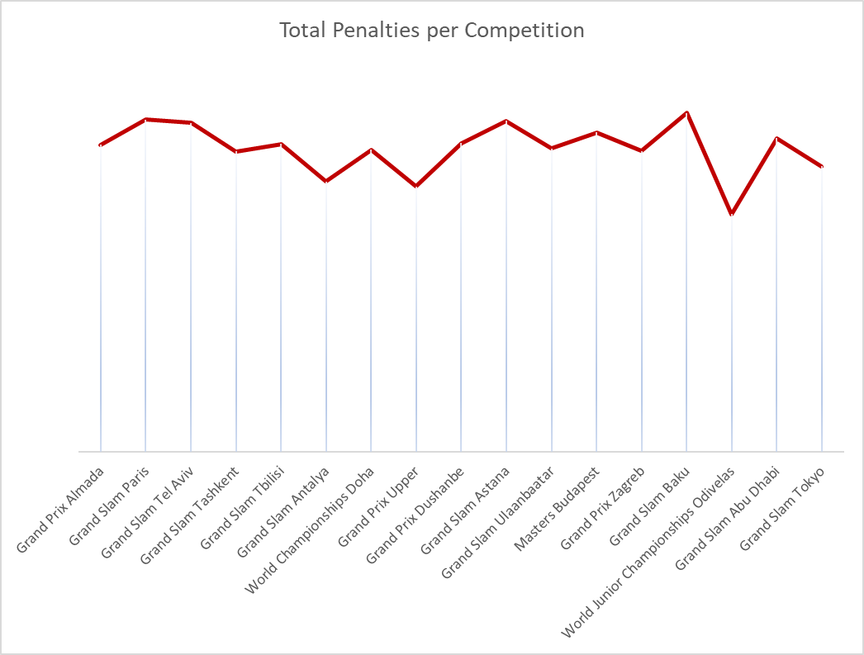
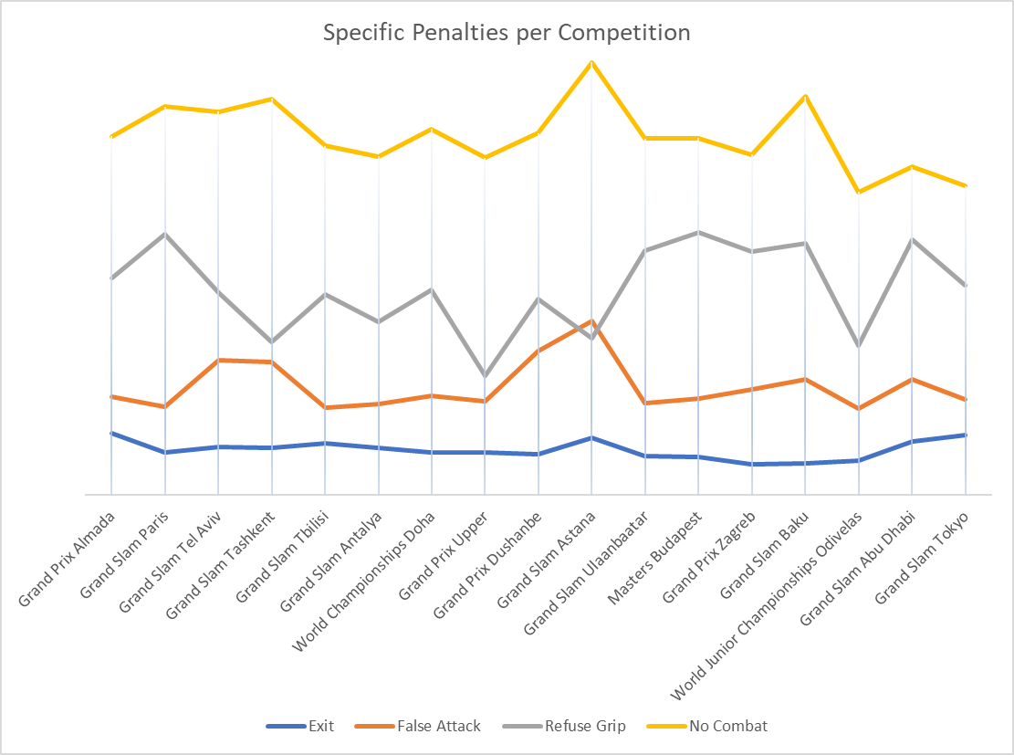
Trend of penalties awarding during the competition
Note.
The number of penalties is related with the number of contest per competition

Slide 13
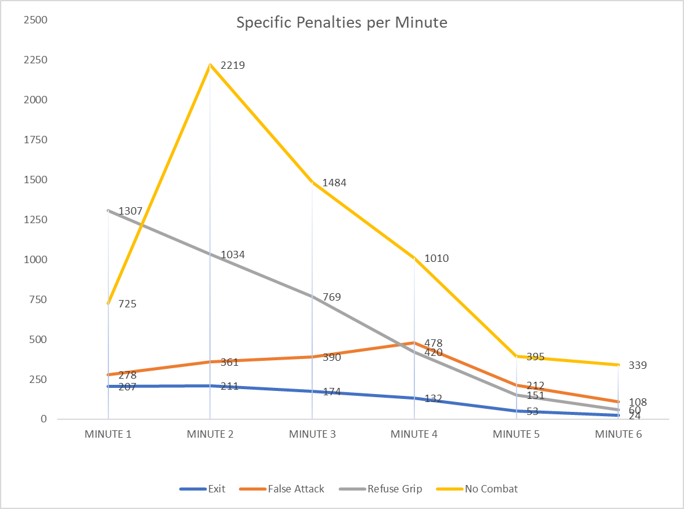
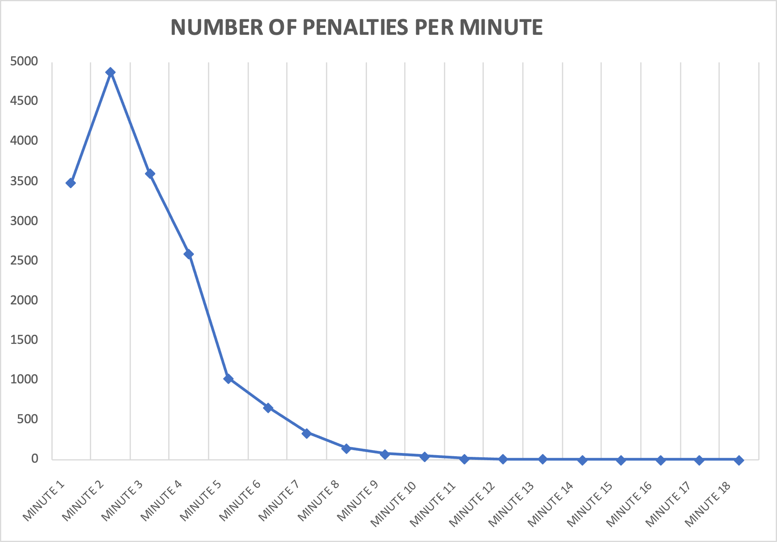
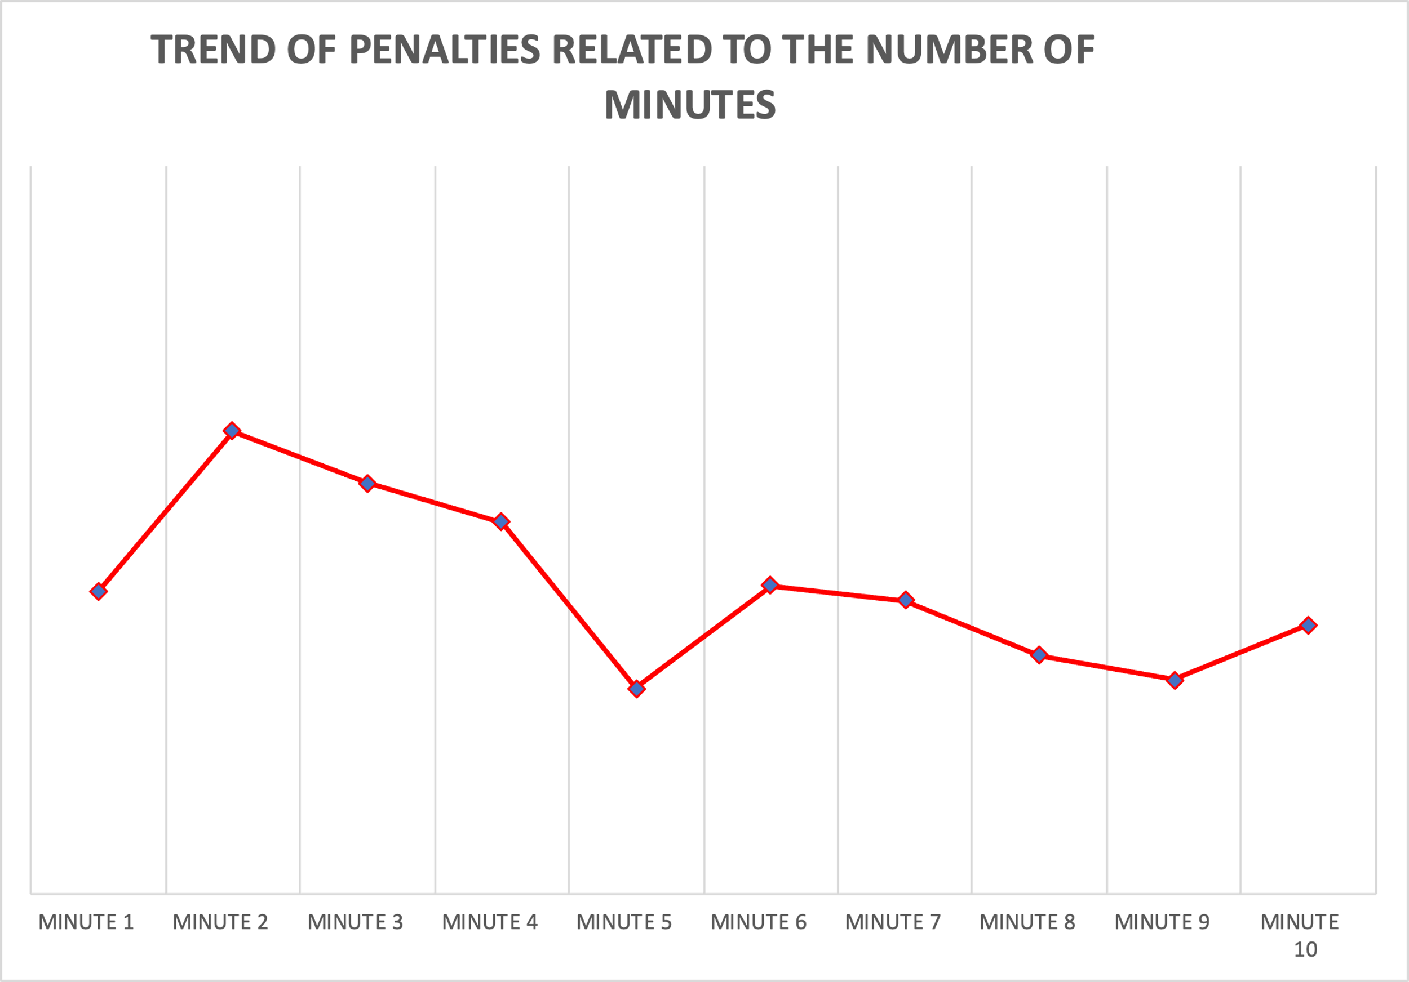
Trend of penalties according to the minute of contest

Slide 14
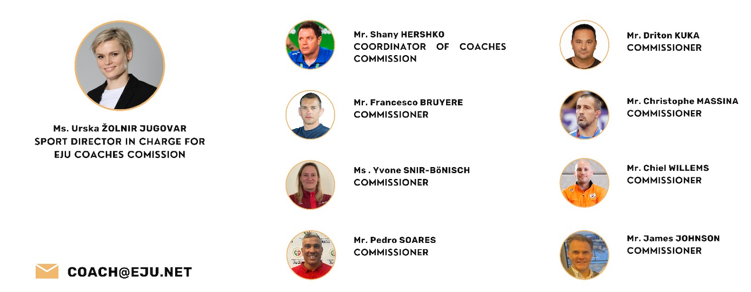
EUROPEAN JUDO UNION
COACH COMMISSION
Thank You Merci Gracias Спасибо

